Slide 1
Computer Architecture: Memory Basics
Dr. Colin O’Flynn

Slide 2
Lectures
How does a program run on a machine?
How do you compile from high-level code to machine code?
How does the machine run? (Control Flow)
How does the machine store data?
How does the machine interface using buses?
What does it mean to have “allowed” memory?
How does the machine speed up data access?

Slide 3
Memory
What is memory?

Slide 4
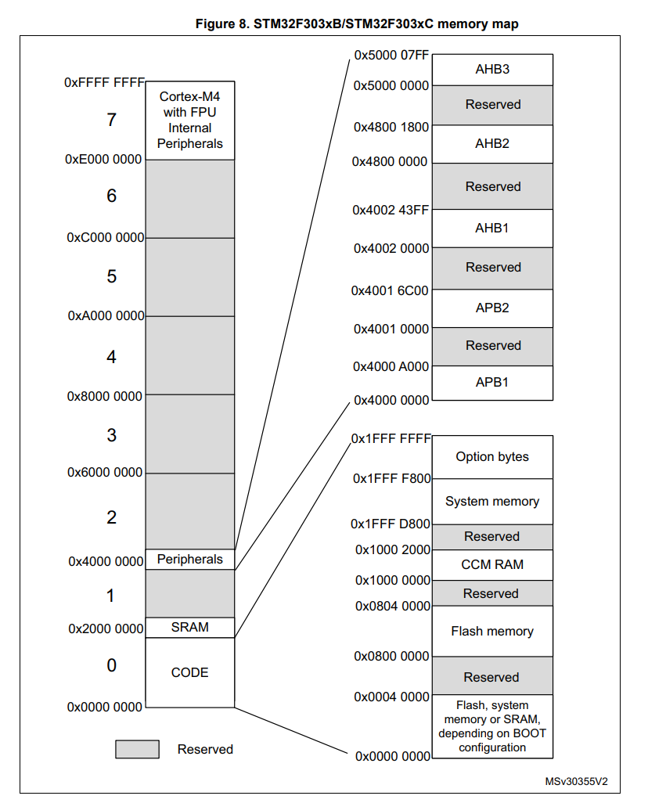
Memory Addressing
The entire memory space is defined by the number of bits in the address bus:
16-bit = 65 KB (65,536)
32-bit = 4 GB (4,294,967,296)
64-bit = 16 EB (18,446,744,073,709,551,616 )
There is no standard when it comes to what address to use.
Address “0” may be invalid – blocks get assigned anywhere in the address space. Sometimes for historical reasons.

Slide 5
Memory Banking
What happens if you run out of memory (e.g., 16-bit, 32-bit)?
Requires banking out memory
Older devices often have memory banks you switch between

Slide 6
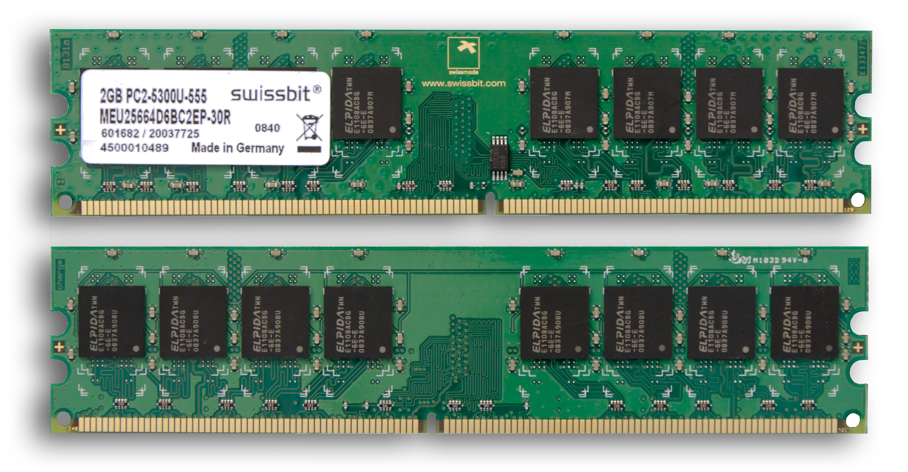
Memory Width
This is the width of the memory itself

Slide 7
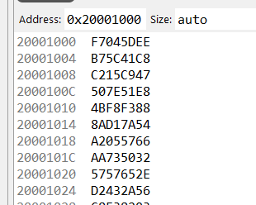
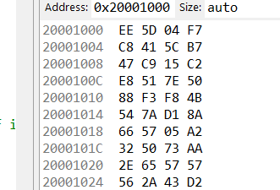
Byte Addressing

Slide 8
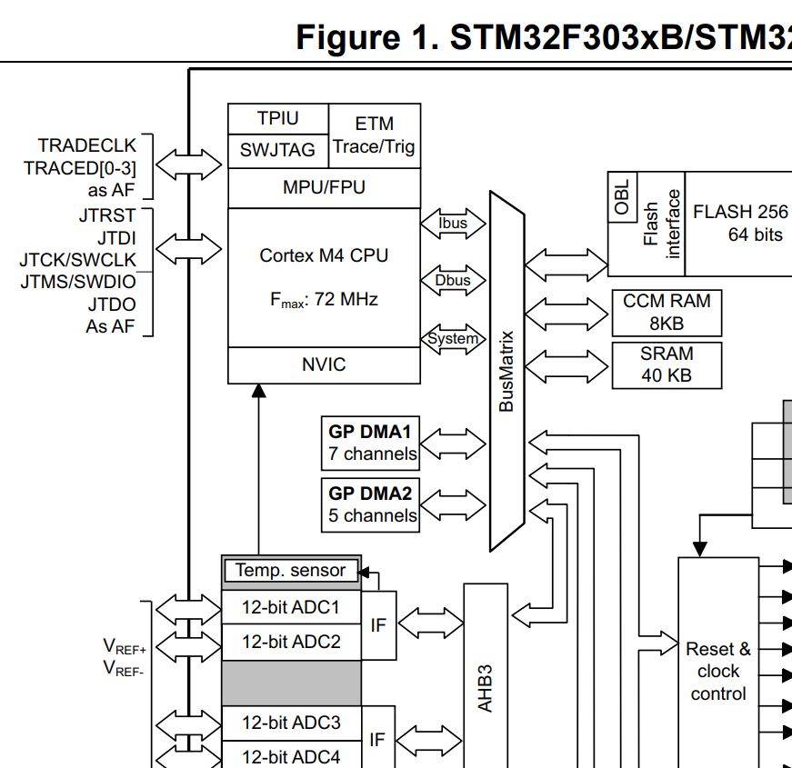
Computer Data Width
This is the width of the computer bus

Slide 9
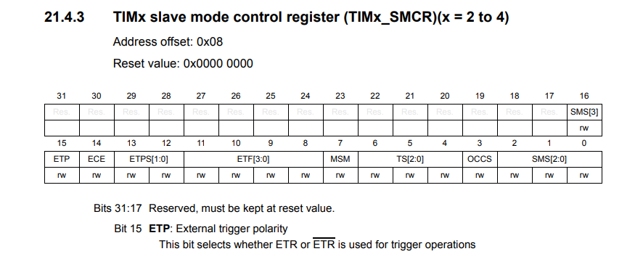
Address Space Mapping
Peripherals are mapped into address space – this may include many small RAMs for example or other small blocks.
It may be possible to move these, often in datasheets/manuals you see registers as an offset for this reason:

Slide 10
von Neumann Architecture
One bus with everything
B U S
Flash (Code)
CPU
RAM (Data)

Slide 11
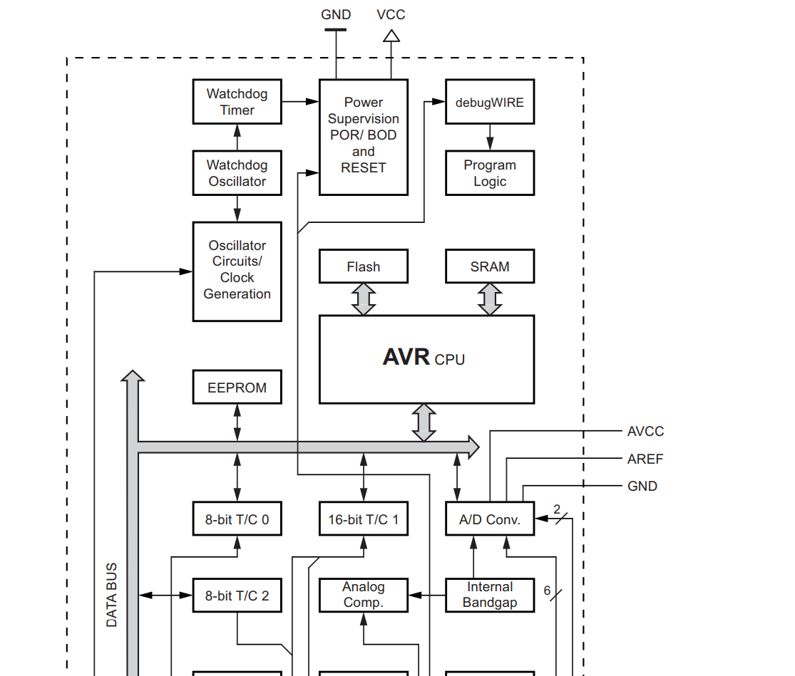
Harvard Architecture
Separate code & data busses
Hardcoded access logic – addresses overlap
Address 0x0000 exists on both memories
Impossible to execute from SRAM
E.g., AVR (ATMega328P at right)

Slide 12
Modified Harvard Architecture
One address space
Possible to execute from any memory
Separate code & data busses
Enables more efficient caching
E.g., Cortex-M (STM32F3 at right)
Most microcontrollers are this now

Slide 13
Memory Behaviour
Different memory will have different times
What happens if memory is not fast enough?
CPU Stall

Slide 14
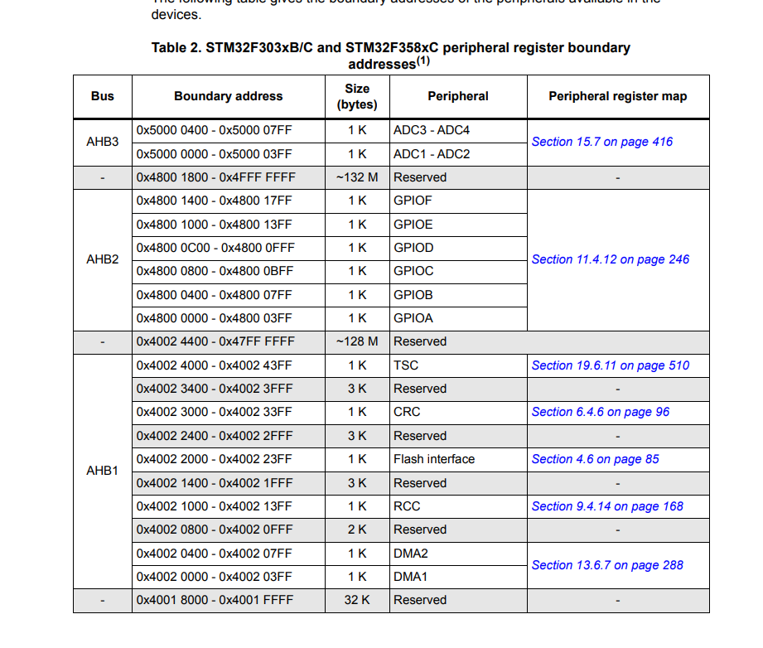
Memory-Mapped I/O

Slide 15
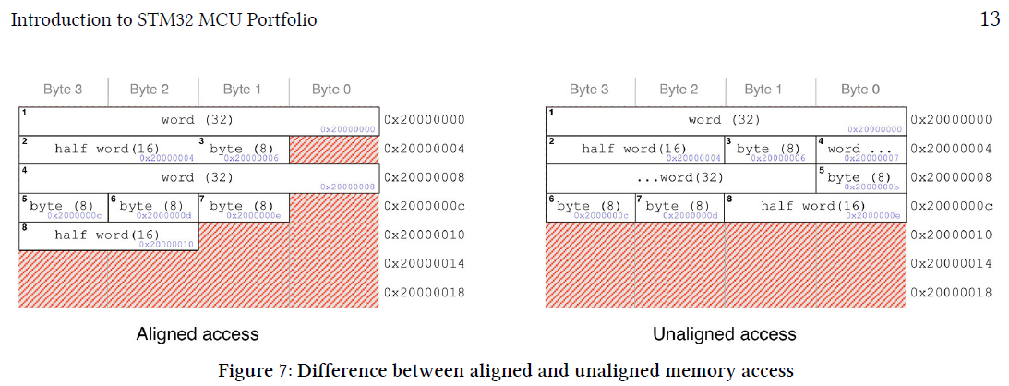
Memory Alignment

Slide 16
Memory Alignment

Slide 17

Misaligned Memory Access
Some devices will throw a fault exception when accessing unaligned data, e.g.:
Cortex-M0, M1 do not support unaligned access like above
Cortex-M3 do work, but hardware is doing multiple accesses (slower)

Slide 18
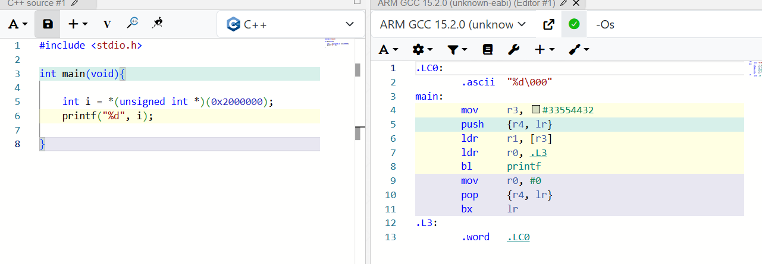
Generic Aligned Access – Normal Read

Slide 19
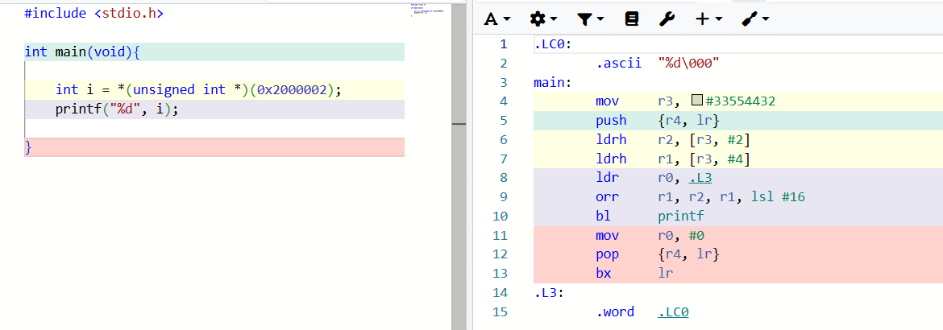
Generic Unaligned Access – Half Off

Slide 20
Generic Aligned Access – Half Off
+2
+4

Slide 21
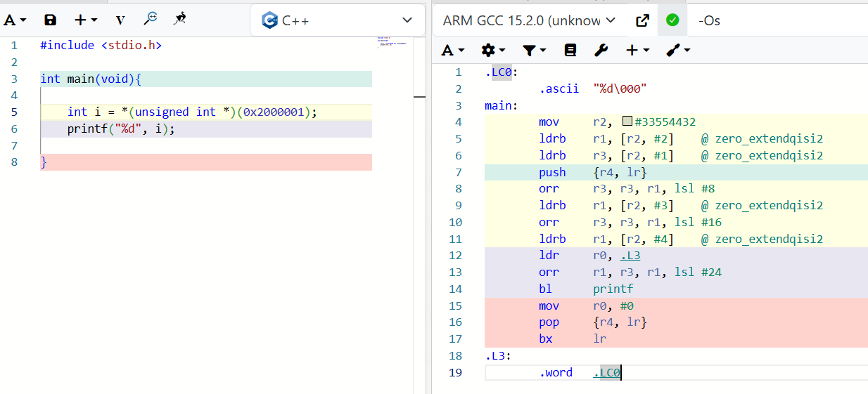
Generic Unaligned Access – 1 Off

Slide 22
Generic Unaligned Access – 1 Off

Slide 23
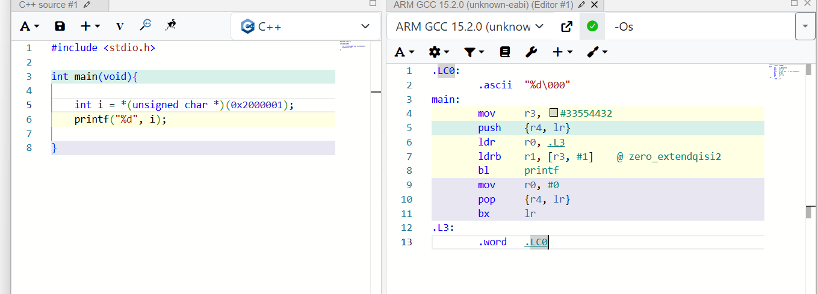
Generic Unaligned access – 1 byte

Slide 24
Single Byte Access Without ldrb

Slide 25
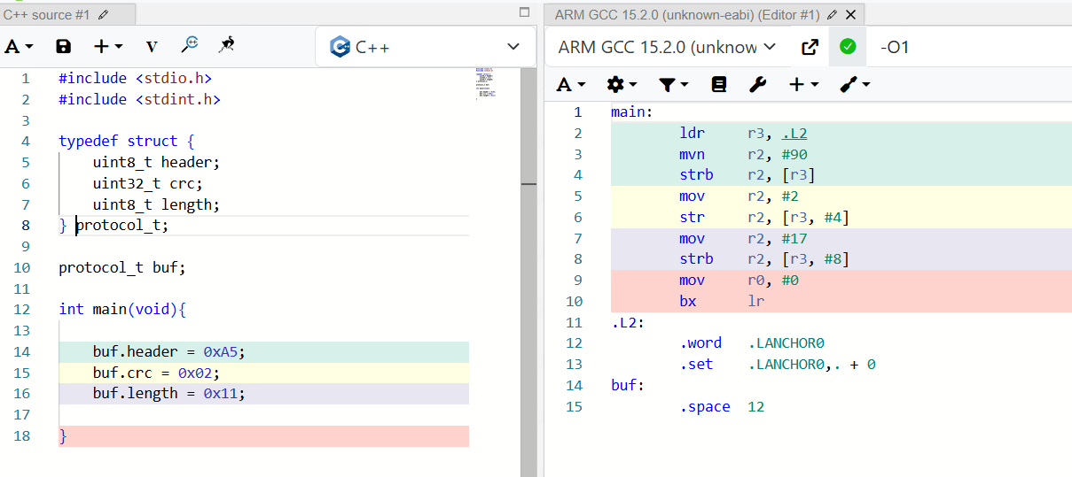
Memory Struct Padding / Layout

Slide 26
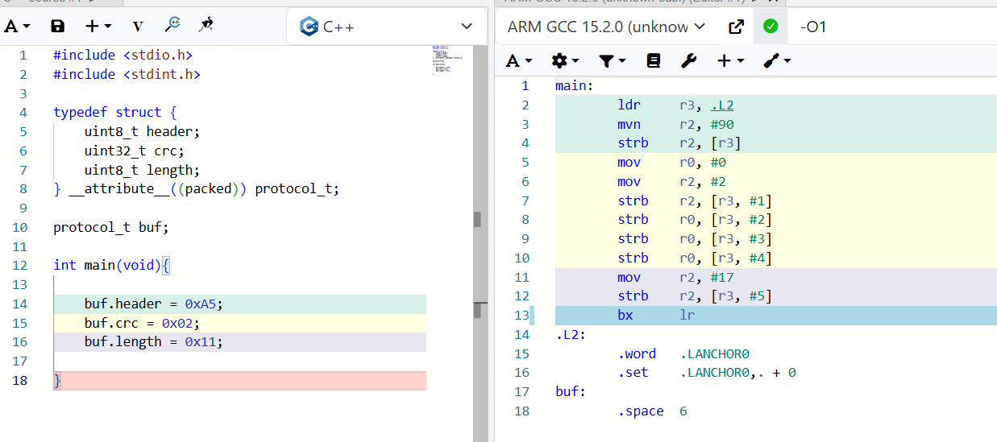
Memory Struct Padding / Layout

Slide 27
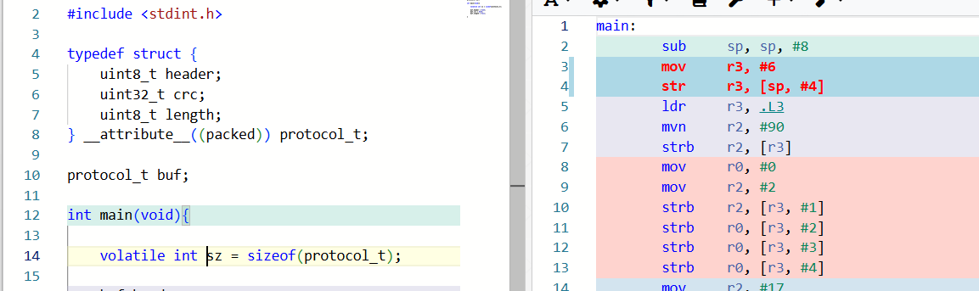
Struct Packing
When dealing with protocols & structs – be very careful ensuring this is working as intended.
Quick tip: use sizeof() on the struct to detect packing:

Slide 28
Endianness – Little Endian Byte Ordering
Least Significant Byte (LSB)
Most Significant Byte (MSB)
0x20001000 = EE
0x20001001 = 5D
0x20001002 = 04
0x20001003 = F7

Slide 29
Network & Host Order
In computer programs we often have a host order representing the native format that load & store will use.
If we need to send out on a protocol (“network”), we need to convert to network order.
You may run across “host to network” and “network to host” macros that do this.

Slide 30
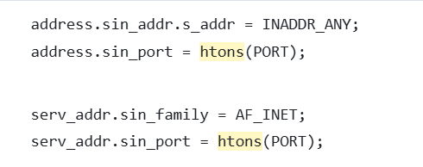
e.g., htons() macro in some random code:

Slide 31
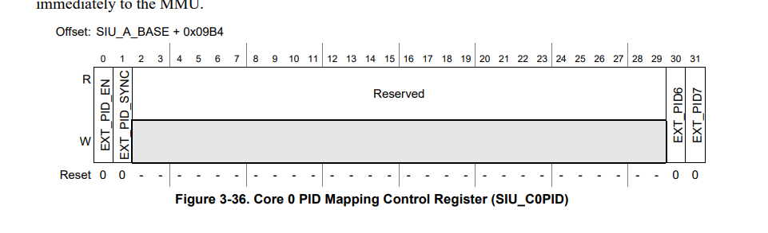
Endianness – Bit Ordering
Be aware processors can use big endian – in which case watch carefully in datasheets, as for example peripheral bit maps will look “backwards”. MPC5676R, PowerPC, example:

Slide 32
Memory Reordering
ldr r0, [x]
ldr r1, [y]
add r0, r0, r1
str [i], r0
ldr r2, d
add r2, #25
str [y], r1
i = x + y;
y = 25 + d;

Slide 33
Memory Reordering
ldr r0, [x]
ldr r1, [y]
add r0, r0, r1
str [i], r0
ldr r2, d
add r2, #25
str [y], r1
Load [x]
Load [y]
i = x + y;
y = 25 + d;
Store [i]
Load [d]
Store [y]

Slide 34
Memory Re-Ordering
Provided functionality is not impacted, memory access order may be optimized.
Often this means accesses may be “merged”
This may happen especially due to slow memory that takes longer than a single cycle (otherwise processor stalls).
Arm calls this memory type “normal memory”.

Slide 35
Special Memory Types
Arm defines a type of “device memory”
Think of peripherals where you need access to occur in the right order – the actual write (or sometimes read) may have side effects or otherwise needs to happen in the program order.
Device memory can have different attributes allowing fine-tuning of these settings.

Slide 36
Barriers
Barriers provide special instructions to block execution until conditions met.
Data Memory Barrier
Data Synchronization Barrier
Instruction Synchronization Barrier

Slide 37
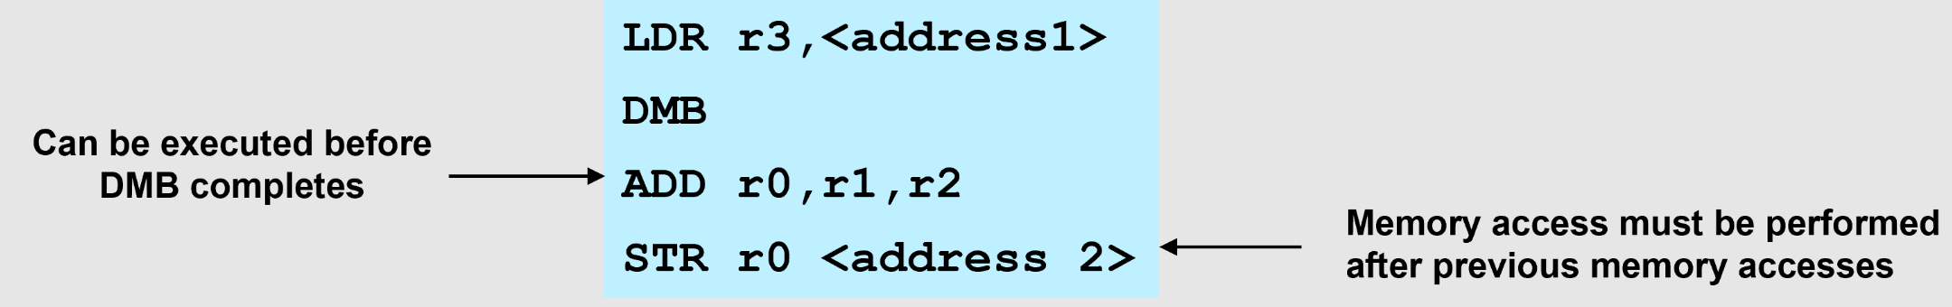
Data Memory Barrier (DMB)
Pauses program at the next memory access if the previous one isn’t complete

Slide 38
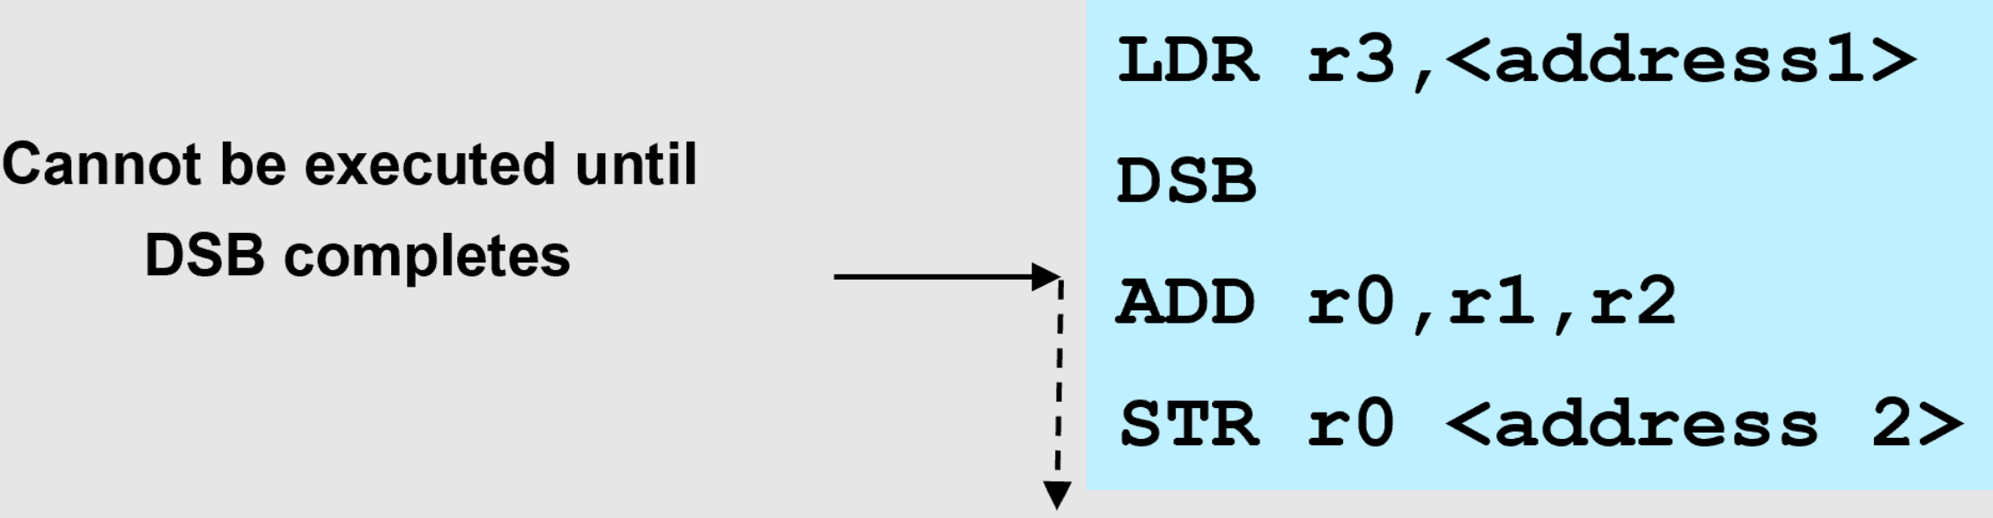
Data Synchronization Barrier (DSB)
Pauses program execution until memory accesses are complete.

Slide 39
Instruction Synchronization Barrier (ISB)
This is not related to memory – this flushes the pipeline which will discuss later.
Included here to complete the types…

Slide 40
Summary
Memory is a critical component of our computer.
More than just a data store – we use memory and addressing to interact with the world (I/O).
Addresses are a construct – we map different blocks into addresses.
Memory alignment is an important concept, one you will run into many times in your programming life.
Endianness defines the byte (or bit) order

